Slide 1
AIND Udacity

Slide 2
Reference
Artificial Intelligence – A Modern Approach
Korf, 1991, Multi-player alpha-beta pruning (for multiple players isolation)

Slide 3
Introduction
What is an intelligent?
One that takes actions to maximize its expected utility given a desires goal.

Slide 4
Agent, Environment and State (& goal state)
Perception
an agent interacts with the environment by sensing its properties.
Cognition
the process by which an agent decides what action to take based on its perceived inputs.
Environment state:
Fully observable vs Partially observable
Deterministic (know for sure the result of the action) vs Stochastic
Discrete (finite number of state) vs Continuous
Benign (the agent is the only one taking actions) vs Adversarial

Slide 5
Game

Slide 6
Sudoku Udacity AIND Project 1

Slide 7
Sudoku
Step 1: Build inputs:
boxes, row_units, column_units, diag_units, square_units, unitlist, units, peers
Step 2: Constraint propagation:
Strategy 1: Elimination
依據數獨本身的規則限制刪掉數字。
Strategy 2: Only Choice
peer裡不確定的格子中，有一個可能的數子只出現在某個格子裡，則那個就一定是那個數字。
Strategy 3: Naked Twins
peer裡不確定的格子中，有兩格有相同的兩個可能數字，其它peer的格子就不能有這兩個數字。
Step 3: Search
還沒解開的話，找可能性最少的格子，一個一個試可能的數字

Slide 8
Isolation Udacity AIND Project 2

Slide 9
Isolation - Introduction
Building a game tree, opening book
Number of nodes in a game tree: b^d
b: the average branching factor (branching factor = 分支)
d: the depth of the game tree
In a 5*5 isolation: the average branching factor=8

Slide 10
Isolation
Minimax Algorithm
計算太大
Implementation
Branching Factor: b^d 仍然很大
Depth-Limited Search
Evaluation Function: +-1 -> #my moves Search 到不同的level數，結果不同
Quiescent Search
Iterative Deepening
Still get the trouble: Horizon Effect
Improve Evaluation Function (#my moves-#opponents moves, #my moves – 2 * #opponents moves)
Minimax Algorithm + Alpha-Beta Pruning

Slide 11
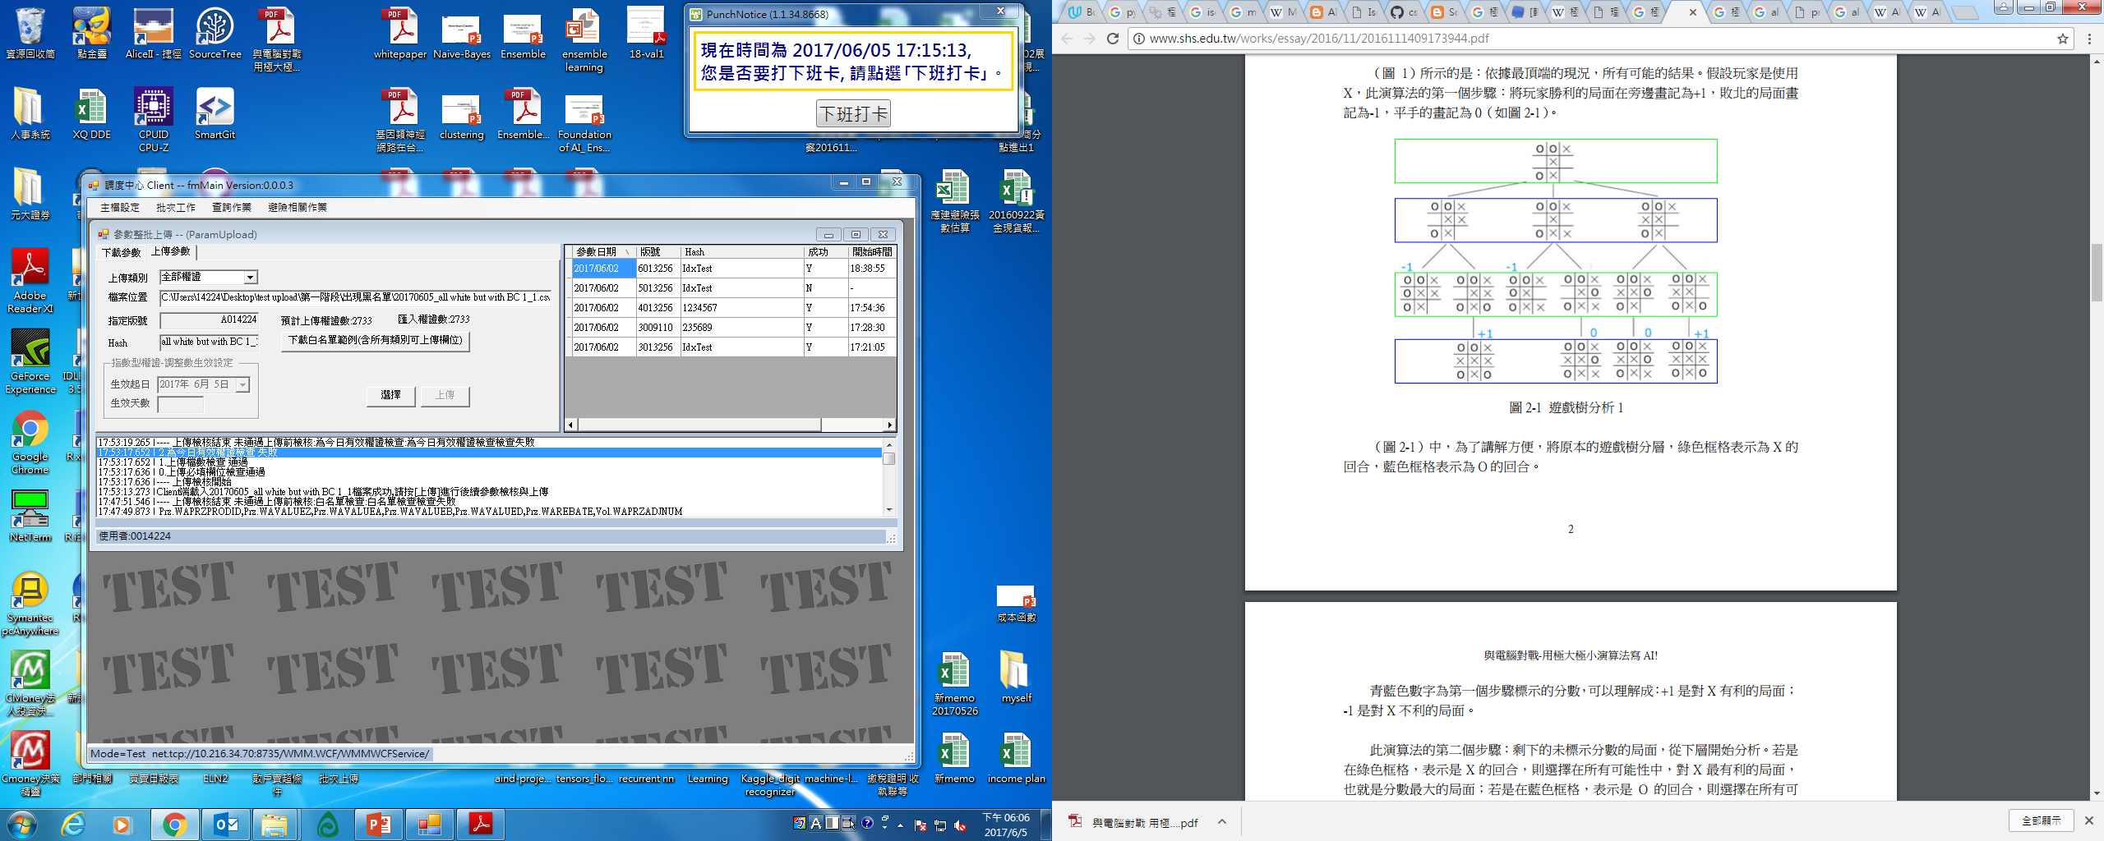
Isolation – Minimax Algorithm
MiniMax Algorithm (極小極大演算法):
是一種找出失敗的最大可能性中的最小值的演算法。
Find the best move.
Bottom to top.
大小大小選
For game playing.
常用於棋類等由兩方較量的遊戲和程式。
一個零總和演算法。
一方要在可選的選項中選擇將其優勢最大化的選擇，另一方則選擇令對手優勢最小化的方法。

Slide 12
Isolation
Evaluation Function:
Number my move for convenience.
Improve evaluation function -> #my moves-#opponents moves (#my moves – 2 * #opponents moves)
Depth limited search:
The whole point of limiting the depth of our search and using an evaluation function is to avoid the exponential explosion in the number of nodes we have to examine.
限制時間，計算這樣的時間可以Search到多深，找到可以Search的level數
E.g. 10^9 nodes * 2 sec -> 8^x < 2*10^9 => x = …
Quiescent Search:
with quiescence search we have to search the game three for two levels and maybe a whole lot more if the results are changing between levels. -> don’t have to use quiescence search all the time.
Iterative deepening:
從level1開始search (evaluation function)，若在時間內，則記下目前最好的，再開始search level 2，直到run out of time
b=k, n(nodes) = ((k^(d+1)) -1)/(k-1)
Always has an answer ready in case it runs out of time and it can search as far as possible within its time constraints
Horizon Effect:
The game will be decided in the next move, but that the computer player cannot search far enough into the future to figure out the problem.

Slide 13
Isolation – Minimax + Alpha-Beta Pruning
A pruning technique that allows us to ignore whole sections of the game tree, but still get the same answer as with minimax.
Never change the answer, but much more efficient than minimax.
「Alpha-Beta 修剪法」其實是「Min-Max 對局搜尋法」的一個修改版，主要是在 Min-Max 當中加入了 α 與 β 兩個紀錄值，用來做為是否要修剪的參考標準。
Alpha is the best already explored option along the path to the root for the maximizer (maximum lower bound of possible solutions)
Beta is the equivalent for the minimizer that is the best already explored option along the path to the root for the minimizer. (minimum upper bound of possible solutions.)
Alpha <= N <= Beta
http://inst.eecs.berkeley.edu/~cs61b/fa14/ta-materials/apps/ab_tree_practice/

Slide 14
Isolation - Tricks
Others
Partition + alpha-beta + symmetry
When player1 first move is center, and then can always reflect player 2’s move, then player1 will always win

Slide 15
Other Isolations
Multiple Players Isolation:
Don’t use minimax anymore
Max N: 每當那個人的回合就選他最好的(要記錄其他人的數字),can work for multiple games with any numbers of players.
multi-player minimax and alpha beta pruning??(max-max-max pruning?)
 |  |  | Hit: 90% | Over: 10%
Probabilistic Game
 |  | Under: 10% | Hit: 80% | Over: 10%
E.g. Sloppy Isolation:
Expectimax: hit: value=1, prob = 0.9, over: value=2, prob=0.1 => 1*0.9+2*0.1=1.1
In general, with Expectimax, you can only prune when you have know bounds on the values that will be returned by the Expectimax function.
Expectimax alpha beta pruning: 一樣的概念，只是數值乘上機率(配合機率總合為1的限制)

Slide 16
n - Queens

Slide 17
n-Queens
Simulated annealing to solve

Slide 18
Sliding Blocks Puzzle

Slide 19
Sliding Blocks Puzzle
h1: # of misplaced blocks
h2: sum(distance of blocks)
h1 is admissible: every tile in the wrong position must be moved at least once to get in the right position.
h2 is admissible: every tile in the wrong position can be moved at least once to get in the right position. No faster than one space per move.
h2 always >= h1.

Slide 20
Sliding Blocks Puzzle
Action Scheme:

Slide 21
Rubik’s Cube

Slide 22
Rubik’s Cube
-> Iterative deepening A*

Slide 23
Pacman Berkeley AI course

Slide 24
Technique

Slide 25
Powerful technique in AI
Search
Pick a box with a minimal number of possible values. Try to solve each of the puzzles obtained by choosing each of these values, recursively.
AI: Do what we do not know (traditional programming: do what we know), and Search is the key area to figure out.
Constraint Propagation
All about using local constraints in a space to dramatically reduce the search space.
(e.g. Sudoku依據限制一個一個把數字刪掉、map coloring, crypto-arithmetic puzzles, …)
aa

Slide 26
Search

Slide 27
Single Agent (e.g. Find the best path from start state to goal state)

Slide 28
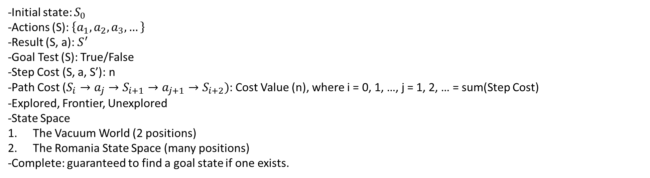
Search – Definition of a problem
Initial state: $S_{0}$
Actions (S): $\left\{a_{1}, a_{2}, a_{3}, …\right\}$
Result (S, a): $S^{′}$
Goal Test (S): True/False
Step Cost (S, a, S’): n
Path Cost ($S_{i}→a_{j}→S_{i+1}→a_{j+1}→S_{i+2})$: Cost Value (n), where i = 0, 1, …, j = 1, 2, … = sum(Step Cost)
Explored, Frontier, Unexplored
State Space
The Vacuum World (2 positions)
The Romania State Space (many positions)
Complete: guaranteed to find a goal state if one exists.

Slide 29
Search – Heuristic (啟發式)
Some additional piece of information – a rule, function or constraint – that informs an otherwise brute-force algorithm to act in a more optimal manner.
A heuristic h(n) is admissible (可採納的) if for every node n, h(n) <= h*(n), where h*(n) is the true cost to reach the goal state from n. -> an admissible heuristic never overestimates the cost to reach the goal, i.e., it is optimistic. e.g.

Slide 30
Search - Type
Avoid repeated path. (Don’t need to return to explored state)
Tree Search
Graph Search
Don’t hold a list of explored nodes.
策略為挑選節點展開的順序
Hold a list of explored nodes.
A node is selected for expansion based on an evaluation function that estimates cost to goal.
Uninformed Search
(Blind Search, Brute Force Search)
Informed Search
(Heuristic Search)
Estimate of the distance from start state to the goal. (Knowledge which is the most useful in search.)
Use only the information available in the problem definition.
Generates the search tree without using any domain specific knowledge.
type
1. Breadth First Search
(1) Uniform Cost Search
2. Depth First Search
(1) Depth Limited Search
(2) Iterative Deepening Search
3. Backwards Chaining
4. Bidirectional Search (雙向搜尋)
Be SMART about what path to try.
Use an evaluation function f(n) for node n.
不保證成功，但可大量節省時間。
type
1. Best First Search
(1) Greedy Best First Search
(2) A* Search
2. Memory Bounded Search
(1) Iterative deepening A* (IDA*)
(2) Recursive Best First Search
(3) Simplified Memory-Bounded A* (SMA*)
3. 疊代改進演算法
(1) Hill Climbing
(2) Simulated Annealing

Slide 31
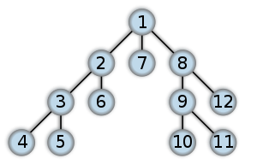
Search – Uninformed Search
Depth First Search 深度優先搜尋法 (longest path)
是一種用來遍尋一個樹(tree)或圖(graph)的演算法。
利用堆疊(Stack)(LIFO)來處理，通常以遞迴的方式呈現。
A kind of graph search.
Not complete.
步驟：
由根來開始探尋，先探尋邊(edge)上未搜尋的一節點(vertex or node)，並儘可能深的搜索，直到該節點的所有邊上節點都已探尋；就回溯(backtracking)到前一個節點，重覆探尋未搜尋的節點，直到找到目 的節點或遍尋全部節點。
以縱向為先，首先選定一個任意節點，假設為V0，由拜訪V0開始。
V0的相鄰節點有V1，V2，…，Vi；然後拜訪V1，再拜訪V1的相鄰節點中的某一節點，如此一直重覆。
若其所有相鄰節點均已被拜訪過，則回到上一個被拜訪過的節點，它還含有未被拜訪過的相鄰節點Vp，就再拜訪Vp。

Slide 32

Search – Uninformed Search
Breadth First Search 廣度優先搜尋法 (Shortest First Search)
利用FIFO佇列(Queue)來處理，通常以迴圈的方式呈現。
A kind of graph search.
Complete.
No Optimality.
使用時機：Used when branching factor is small and shallow solutions exist.
步驟：
從圖的某一節點(vertex, node)開始，接著走訪此一節點所有相鄰且未拜訪過的節點，由走訪過的節點繼續進行先廣後深的搜尋。把同一深度(level)的節點走訪完，再繼續向下一個深度搜尋，直到找到目的節點或遍尋全部節點。
任意選擇某一個開始的節點，假設它為V0，因此先拜訪V0然後以任意的順序去拜訪V0的相鄰節點。
假設V0的相鄰節為V1，V2，…，Vi，當這些節點都拜訪過後，再接著拜訪V1的相鄰節點。
當V1相鄰節點都拜訪過後，再拜訪V2的相鄰節點，如此重覆直到圖形上的所有節點都被拜訪過。
Shortest step
Shortest cost
Uniform Cost Search 成本一致搜尋法 (Cheapest First Search)
Pick the path with the lowest total cost.
利用PriorityQueue來處理
Informed Search
Null heuristic
A* search

Slide 33
Search – informed Search
Best First Search
Greedy Best First Search 貪婪最佳優先搜尋法
- f(n) = h(n) = estimate of cost from n to goal
A* Search
Best estimated total path cost first
Minimum value f(n) = g(n) + h(n) = path length + estimated distance
g(path): path cost
h(path)=h(s): estimated (straight line) distance to goal
A* finds the lowest cost path if h(s) < true cost. It depends on the h function.
f
G
S
X
h: estimated distance
g: path cost so far
Result: Search strategy that is the best possible finds the shortest length path while expanding minimum number of paths possible.
Build heuristic depends on problem.

Slide 34
Search – DFS, BFS, UCS, A*S
Python

Slide 35
Search – informed Search
碰上需要的記憶體太大的問題
Memory Bounded Search
Iterative deepening A*
Recursive Best First Search
Simplified Memory-Bounded A*

Slide 36
Search – informed Search
疊代改進演算法
主要的觀念就是在搜尋的過程中每次只記得現在目前這個點的狀況卻不記得以前走過哪些點了 , 就像在霧裡爬山一樣 , 我們只知道目前所在的位置而只能對周圍的點作探測來決定下一步要往周圍的那一點走 , 如此 , 我們所在的狀態以此方法不斷的更新直到目標點為止

Slide 37
Multiple Agents (e.g. Game, Match)

Slide 38
Search – Adversarial Search <Game>
Agent (from Russell & Norvig):
Simple reflex agents
Simple reflex agents act only on the basis of the current percept, ignoring the rest of the percept history. The agent function is based on the condition-action rule: if condition then action.
This agent function only succeeds when the environment is fully observable. Some reflex agents can also contain information on their current state which allows them to disregard conditions whose actuators are already triggered.
Infinite loops are often unavoidable for simple reflex agents operating in partially observable environments. Note: If the agent can randomize its actions, it may be possible to escape from infinite loops.
Model-based reflex agents
Goal-based agents
Utility-based agents
Learning agents

Slide 39
Search – Adversarial Search <Game>
Add optionally:
Depth-limited search
Mini-max Algorithm
Evaluation Function -
Give a score to mini-max
Work on build and improve evaluation function depend on problems.
alpha-beta pruning

Slide 40
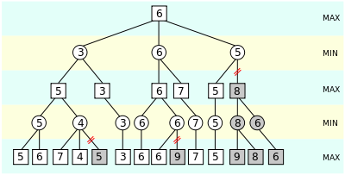
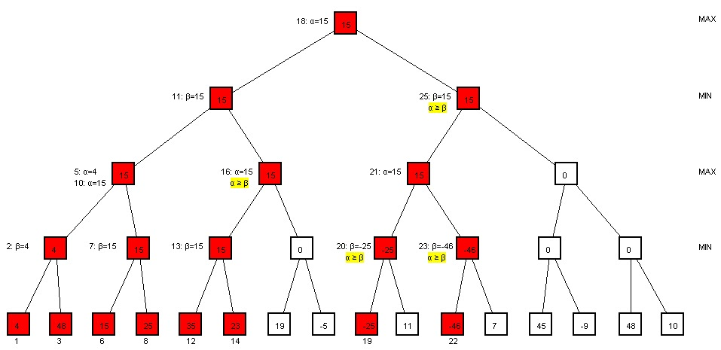
Search – one opponent (might be many agents)
Mini-Max Algorithm:
you are trying to maximize your chances of winning on your turn, and your opponent is trying to minimize your chances of winning on their turn.
Alpha-Beta pruning (help optimize algorithm):
seek to decrease the number of nodes that are evaluated by the mini-max algorithm in its search tree. (practice: http://inst.eecs.berkeley.edu/~cs61b/fa14/ta-materials/apps/ab_tree_practice/)
Evaluation Function:
give score to mini-max
Expecti-max:
add probability concept to opponent’s actions.

Slide 41
Search – 多個對手(可能很多個agent)
Multiple Players Isolation:
Don’t use minimax anymore
Max N: 每當那個人的回合就選他最好的(要記錄其他人的數字),can work for multiple games with any numbers of players.
multi-player minimax and alpha beta pruning??(max-max-max pruning?)

Slide 42
Search - Problems
State Space might be so large that we need other techniques to search the space and find optimal solutions.
Depth-limited search

Slide 43
Planning The construction of sequences of actions to achieve their goal.

Slide 44
Planning vs Search

Slide 45
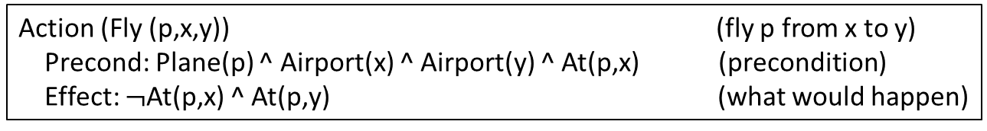
Planning – Classical Planning
Factoring the world into variables.
State Space: k-Boolean (2^k states)
World State: Complete Assignment
Belief State: Complete Assignment, Partial Assignment, Arbitrary Formula
Action Scheme: e.g.
Action (Fly (p,x,y)) (fly p from x to y)
Precond: Plane(p) ^ Airport(x) ^ Airport(y) ^ At(p,x) (precondition)
Effect: $¬$At(p,x) ^ At(p,y) (what would happen)
How do we do planning:
STRIPS (State Space Search)
Progression Search
Regression Search
PSS (Plan Space Search)
STN
Situation Calculus

Slide 46
Planning
Planning problems
problems(): build problems
cargos, planes, airports, pos, neg, init = FluentState(pos, neg), goal
get_actions(): creates concrete actions (no variables) for all actions in the problem domain action schema and turns them into complete Action objects. (use for loop to create a list of all possible actions.)
load_actions() : precond_pos, precond_neg, effect_add, effect_rem
unload_actions() : precond_pos, precond_neg, effect_add, effect_rem
fly_actions() : precond_pos, precond_neg, effect_add, effect_rem
actions(): Return the actions that can be executed in the given state.
From all the concrete actions we can perform, select the ones that can be executed from the current state. An action is executable if it satisfies a problem's preconditions. That is, it must appear in a problem's positive preconditions and not be in a problem's negative ones.
results(): Return the state that results from executing the given action in the given state.
The precondition defines the states in which the action can be executed, and the effect defines the result of executing the action. So, for each fluent (positive or negative) in the old state, we need to look in the action's effects (both the add and remove effects) to determine how the fluent will be carried over to the new state, as a positive or a negative fluent. The action may have positive and negative effects INDEPENDENTLY of the old state. If they're add effects, we need to make sure these fluents are added to the new state's positive sentences. Similarly, if they're remove effects, these fluents need to be added to the new state's negative sentences.

Slide 47
Planning
Domain-Independence heuristics
Define heuristic method
Build planning graph:
Add levels
action levels
literal level
Add mutex
Inconsistent effects mutex
Interference mutex
competing needs mutex
negation mutex
inconsistent support mutex

Slide 48
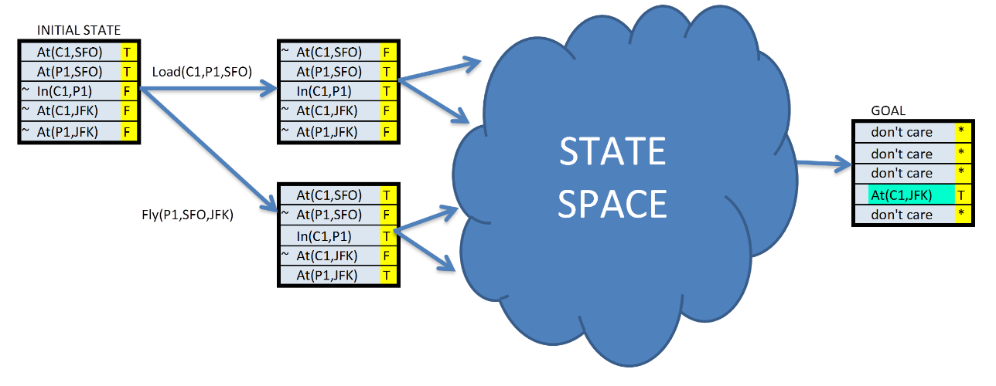
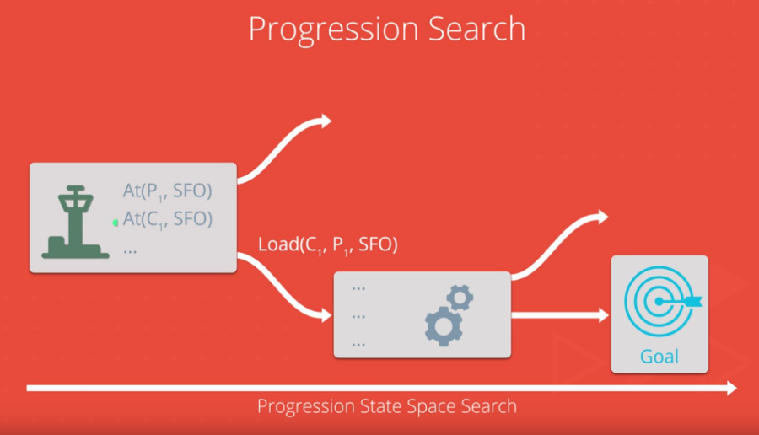
Planning – How do we do planning
1. Progression Search
Progression planning problems can be solved with graph searches such as breadth-first, depth-first, and A*.
The nodes of the graph are "states" and edges are "actions". A "state" is the logical conjunction of all boolean ground "fluents", or state variables, that are possible for the problem using Propositional Logic.
Recall Search:
BFS
DFS
UCS
A*S
…
Level S0
Level A0
Level S1
Level A1
Action
In this simple example, there are five fluents, or state variables, which means our state space could be as large as 2^5 = 32.
State
Fluent
(state variable)
(forward)

Slide 49
Planning – How do we do planning
2. Regression Search
Initial State:
…
………
Node n:
…
Unload (c1, p1, JFK)
Goal:
At(c1, JFK)
At(c2, SFO)
…
What action can result this
(backward) Regression Search
then

Slide 50
Planning – How do we do planning
3. Plan Space Search
- Search through the space of plans rather than search through the space of states.

Slide 51
How Do We Do Planning – Regression vs Progression
Popular now: “Forward Search”
Good heuristic
Concrete plan states

Slide 52
How Do We Do Planning – Situation Calculus
Based on FOL.
Flexible. All the things in few sentences.

Slide 53
HMM Hidden Markov Model

Slide 54
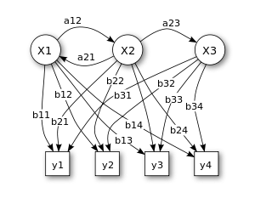
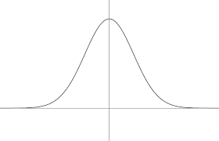



HMM
$$λ_{I}$$
0.8
0.5
0.8
0.2
S1
0.2
S2
0.5
S3
0.2
$$P(Δy)$$
Figure 1. Probabilistic parameters of a hidden Markov model (example) X — states y — possible observations a — state transition probabilities b — output probabilities
$$Δy$$
5
0
-5

Slide 55
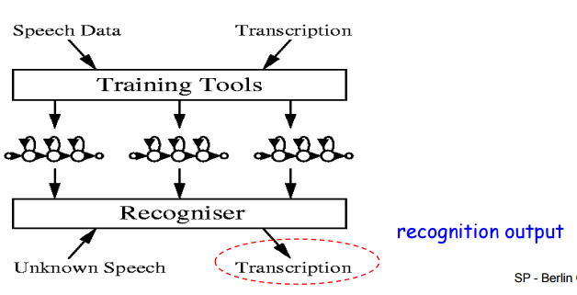
HMM
Step1: Feature Exploration
Feature selection
get_word_Xlengths(‘word’) to get 1. a concatenation of all the sequences(the X portion. 2.a list of the sequence lengths(the Lengths portion).
Step2: Model Selection

Slide 56
Tool

Slide 57
Logic

Slide 58
Logic
Operators
Valid: True in every possible model for every combination of values of the propositional symbols.
Satisfiable: True in some model but not necessarily in all the models.
Unsatisfiable: False in every possible model.

Slide 59
Logic – Propositional Logic
Limitation
Can only handle True & False value, can’t handle uncertainty.
Only talk about True & False event, can’t talk about objects that have properties.
No shortcut to succinctly talk about a lot of different things happening.
First Order Logic

Slide 60
Logic – First Order Logic

Slide 61
Probability

Slide 62
Find The Global Maximum

Slide 63
Random Restart

Slide 64
Local Beam Search (vs Stochastic Beam Search)
k particles
Select the best neighbor.
Once reach the goal, terminate.

Slide 65
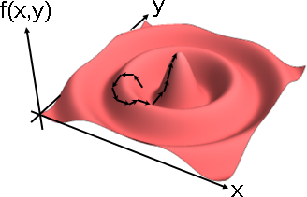
Simulated Annealing
Problem (like hill climbing, Gradient Descent):
Stuck in local maximum, shoulder (step size too small), cross the optimum (step size too large).
a probablistic technique used for finding an approximate solution to an optimization problem.
一種Markov chain Monte carlo(馬可夫蒙地卡羅)的延伸。
Technique to navigate a potentially large space.
在固定時間內尋求在一個大的搜尋空間內找到的最優解。當你搜尋的時間夠久，你就能找到愈接近global optimum的解。
登山法改良版。允許往下走，以便翻山越嶺。
隨便往某個方向跨出一步，確定是往上，就走；確定是往下，以機率 exp(Δf⋅t) 決定走或不走，其中 Δf 是上升高度（往下走時是負值）， t 是時刻（大於等於 1 ）。大致上來說，往下越陡就越不想往下，年紀越大就越不想往下。
註：原論文只找山谷、未找山峰。原論文沒有時刻 t ，而是溫度 T ；溫度不斷下降，因此機率公式是 exp(Δf/T) 。
適用：連續函數。缺陷：可能停在山腰。可能只找到區域極值。

Slide 66
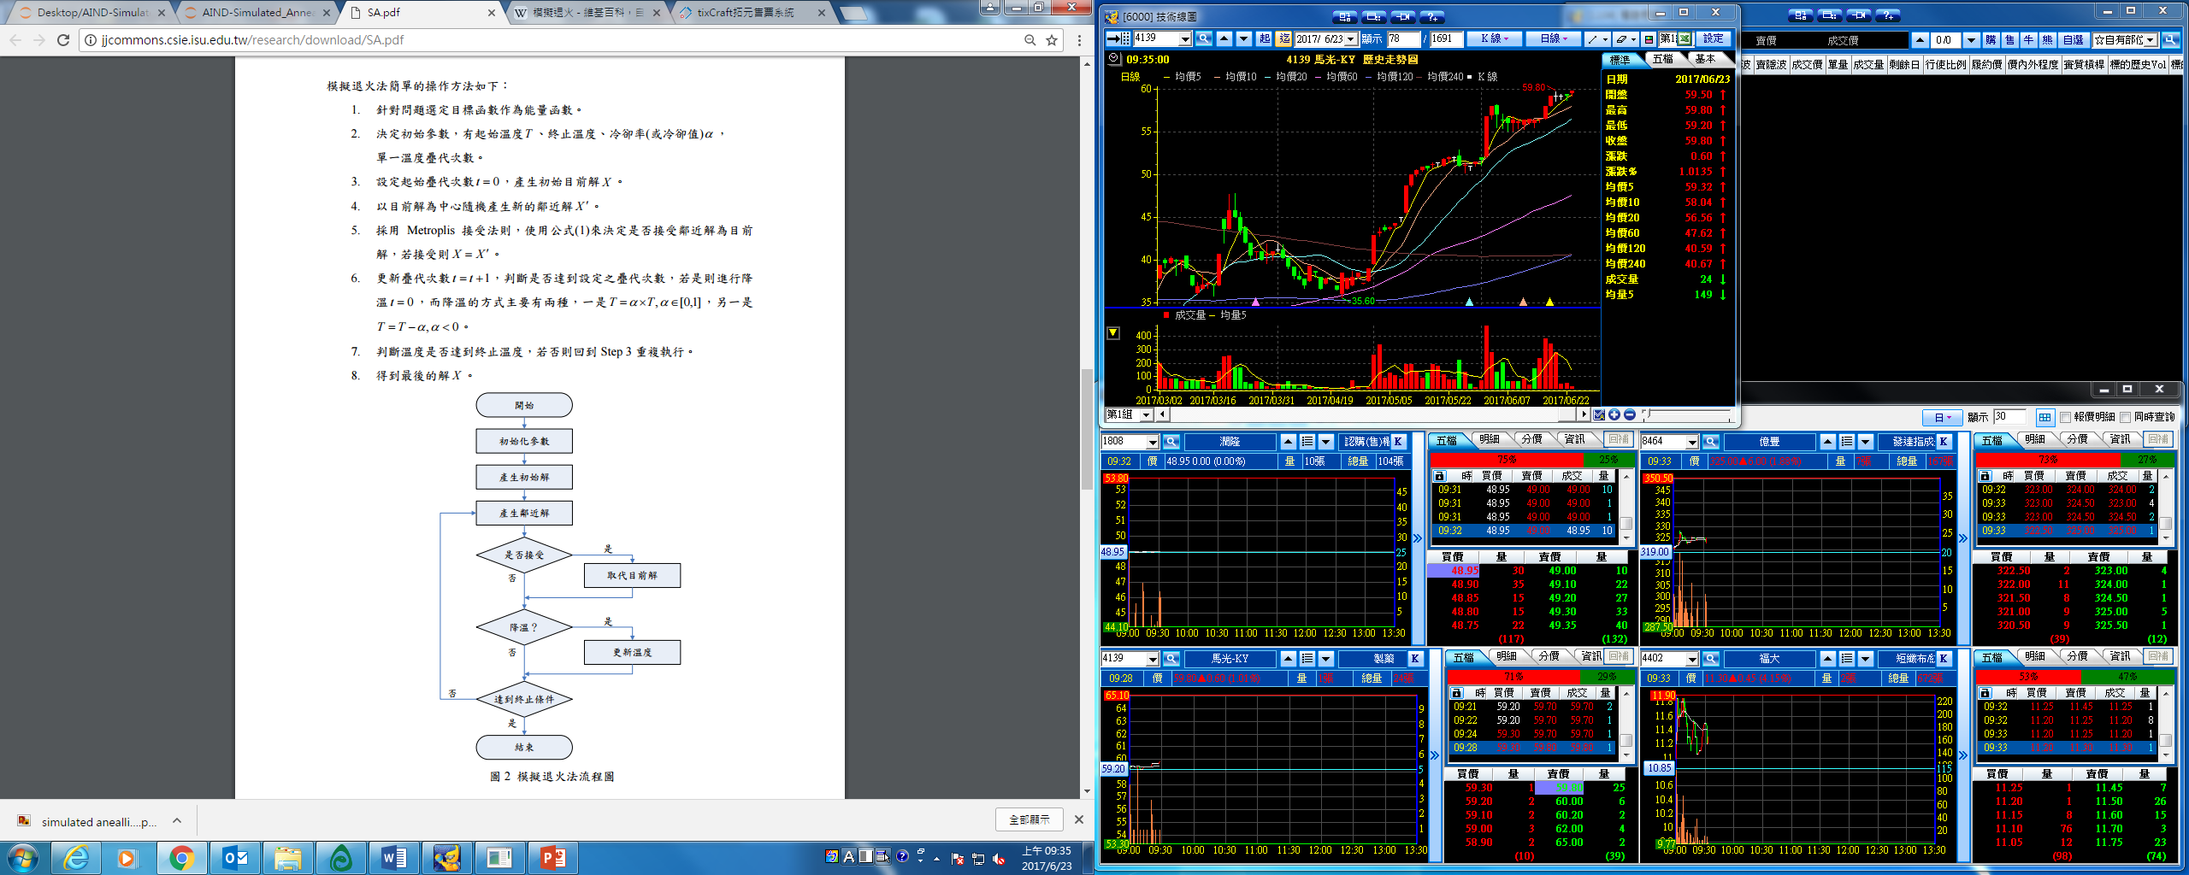
Simulated Annealing

Slide 67
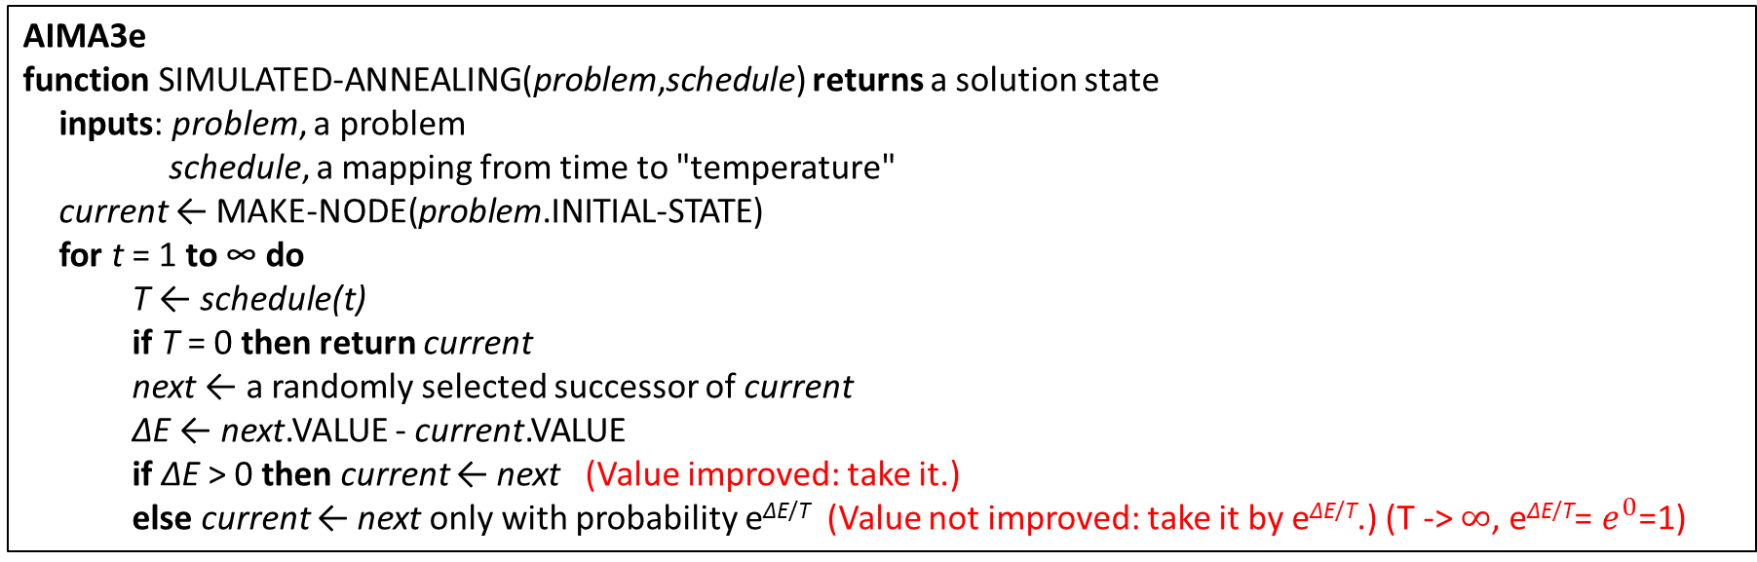
Simulated Annealing
The main loop of simulated annealing repeatedly generates successors in the neighborhood
of the current state and considers moving there according to an acceptance probability distribution
parameterized by a cooling schedule.
AIMA3e
function SIMULATED-ANNEALING(problem,schedule) returns a solution state inputs: problem, a problem schedule, a mapping from time to "temperature"
current ← MAKE-NODE(problem.INITIAL-STATE) for t = 1 to ∞ do T ← schedule(t) if T = 0 then return current next ← a randomly selected successor of current ΔE ← next.VALUE - current.VALUE if ΔE > 0 then current ← next (Value improved: take it.) else current ← next only with probability e^{ΔE/T} (Value not improved: take it by e^{ΔE/T}.) (T -> $∞$, e^{ΔE/T}= $e^{0}$=1)
The simulated annealing algorithm, a version of stochastic hill climbing where some downhill moves are allowed.
Downhill moves are accepted readily early in the annealing schedule and then less often as time goes on.
The schedule input determines the value of the temperature T as a function of time.

Slide 68
Simulated Annealing
Pseudo-code
T_MAX = 1000 # 初始溫度
T_MIN = 10 # 設定結束溫度
T = T_MAX # 設定目前溫度
markov_step = 100 # 設定馬可夫鍊學習的次數
current_state = generate_init_state() # 隨機產生初始狀態
current_energy = energy_function(current_state, T) # 產生目前的能量
while T尚未到達T_MIN
for i=1:markov_step
new_state = generate_new_state(current_state) # 依據目前的狀態產生新的狀態
new_energy = energy_function(new_state, T) # 計算新狀態的能量
alpha = acceptance(new_energy, current_energy, T) # 經由函數計算出一個接受的機率值
if rand() <= alpha
# 接受新的狀態
else
# 拒絕新的狀態
end
# 降溫
end
end
Step1: Read input data and define helper functions for visualization.
Step2: Define simulated annealing main loop
Step3: Representing the problem
Step4: Define the temperature schedule
Step5: Run

Slide 69
Genetic Algorithms

